Slide 1
The Deep Sea

Slide 2
Inhoud
Eerste sprint
PvE/Werkzaamheden
Technisch ontwerp
Keuzes
GDD
Volgende sprint
PvE/Werkzaamheden
Technisch ontwerp
Keuzes
GDD
Software
Welke
Inrichting

Slide 3
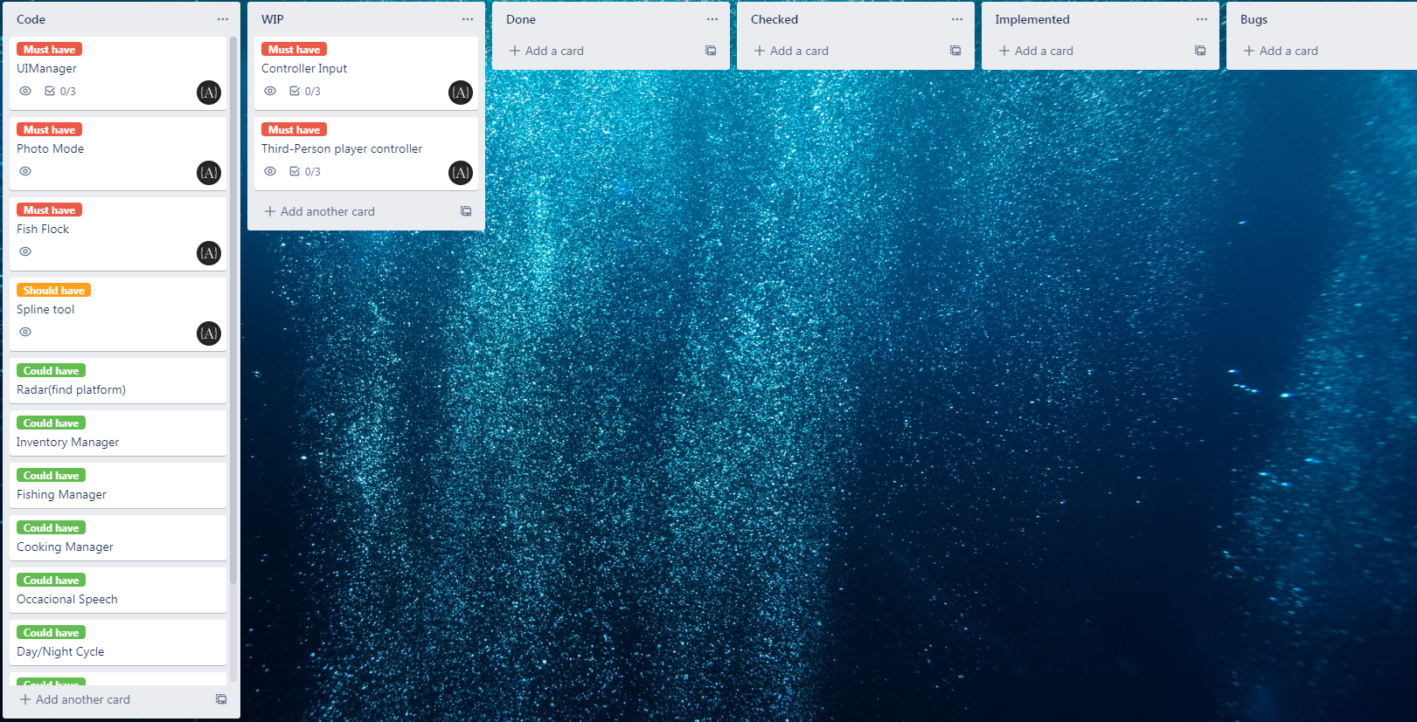
Eerste sprint
PvE
Third-person controller
Controller support
Intuitieve controls
Minimale HUD
 | Week 1 | Week 1 | Week 2 | Week 2
Maandag | Character controller | Character controller | UI (Photo mode) | UI (Photo mode)
Dinsdag | Character controller | Controller support | UI (Photo mode) | UI (Photo mode)
Woensdag | Controller support | Controller support | UI (Photo mode) | UI (Photo mode)
Donderdag | Presentatie K1 W2/3/4 | Presentatie K1 W2/3/4 | OFF DAY | OFF DAY
Vrijdag | OFF DAY | OFF DAY | OFF DAY | OFF DAY
Zaterdag | OFF DAY | OFF DAY | OFF DAY | OFF DAY
Zondag | OFF DAY | OFF DAY | OFF DAY | OFF DAY

Slide 4
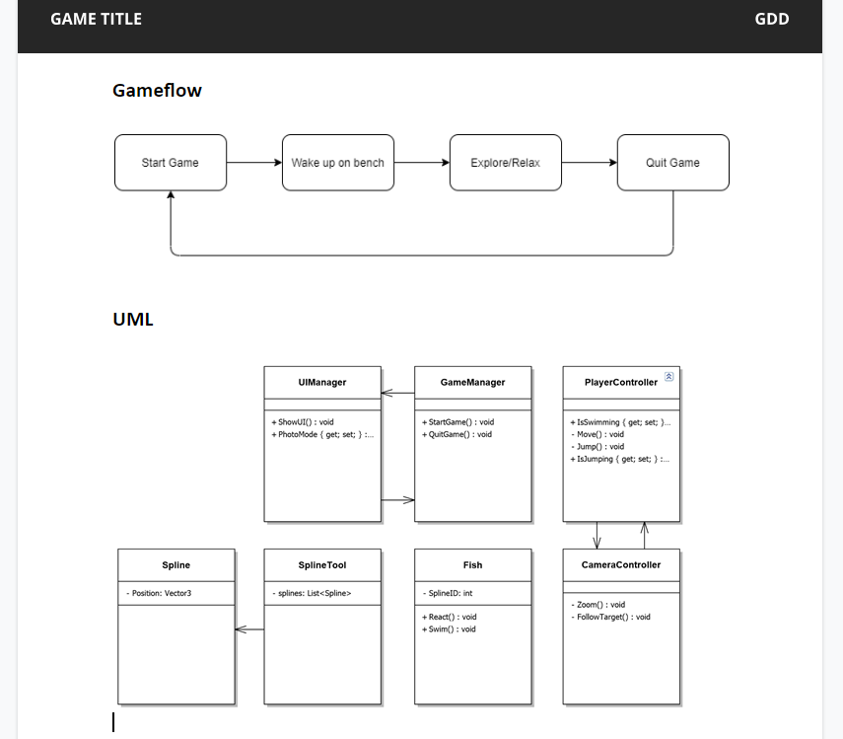
Technisch ontwerp
Keuzes
Minimaal
Overzicht
Controller only
Uitbreidbaar

Slide 5
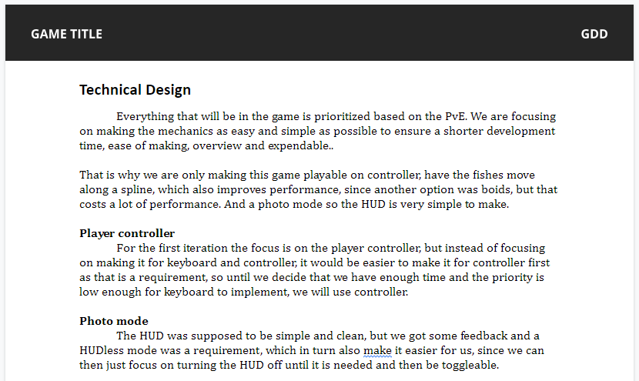
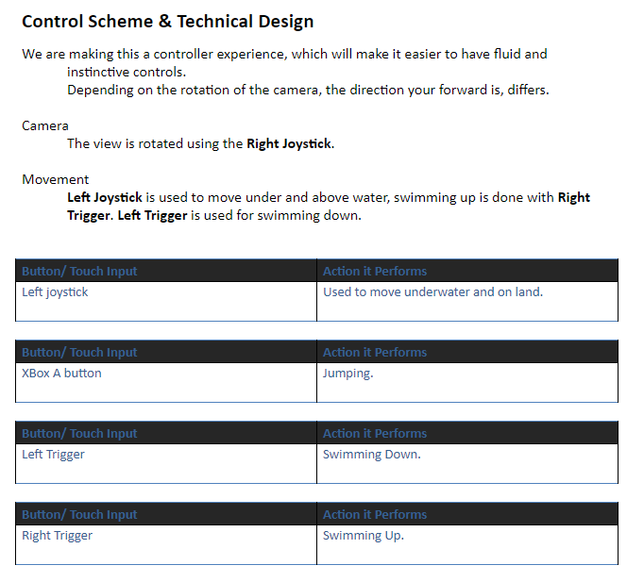
Technisch ontwerp
GDD

Slide 6
Volgende sprint

Slide 7
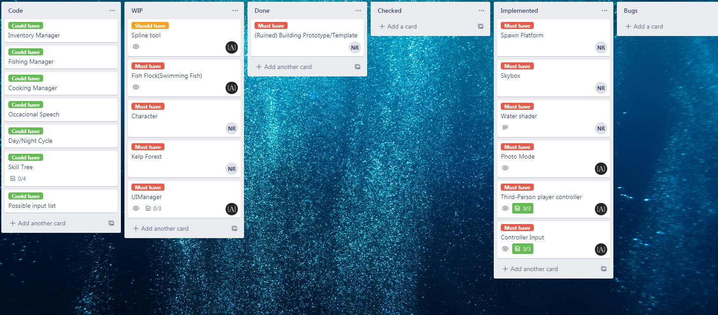
Volgende sprint
PvE
Zwemmende vissen
Vissen reageren op speler
 | Week 1 | Week 1 | Week 2 | Week 2
Maandag | Character controller | Character controller | UI (Photo mode) | UI (Photo mode)
Dinsdag | Character controller | Controller support | UI (Photo mode) | UI (Photo mode)
Woensdag | Controller support | Controller support | UI (Photo mode) | UI (Photo mode)
Donderdag | Presentatie K1 W2/3/4 | Presentatie K1 W2/3/4 | OFF DAY | OFF DAY
Vrijdag | OFF DAY | OFF DAY | OFF DAY | OFF DAY
Zaterdag | OFF DAY | OFF DAY | OFF DAY | OFF DAY
Zondag | OFF DAY | OFF DAY | OFF DAY | OFF DAY
 | Week 3 | Week 3 | Week 4 | Week 4
Maandag | Spline Tool | Spline Tool | Fish Flock | Fish Flock
Dinsdag | Spline Tool | Spline Tool | Fish Flock | Fish Flock
Woensdag | Spline Tool | Spline Tool | Fish Flock | Fish Flock
Donderdag | OFF DAY | OFF DAY | OFF DAY | OFF DAY
Vrijdag | OFF DAY | OFF DAY | OFF DAY | Sprint Review
Zaterdag | OFF DAY | OFF DAY | OFF DAY | OFF DAY
Zondag | OFF DAY | OFF DAY | OFF DAY | OFF DAY

Slide 8
Technisch ontwerp
Keuzes
Performance
Simpel
Controle

Slide 9
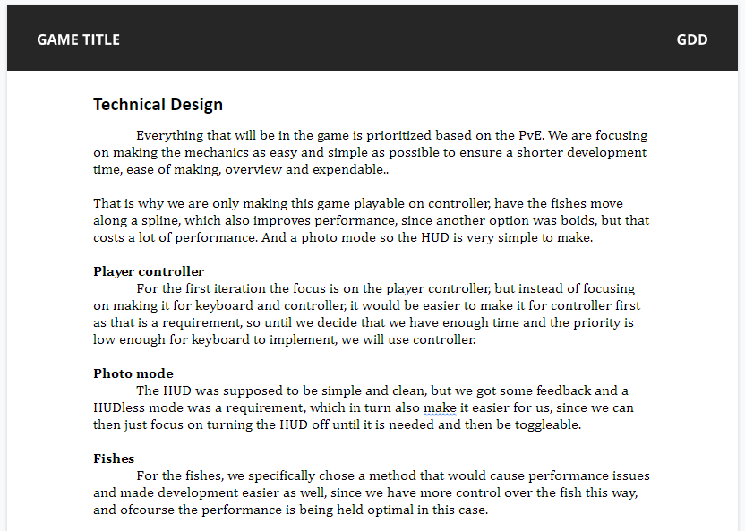
Technisch ontwerp
GDD

Slide 10
Software
Welke
Github desktop (team)
Visual studio 2019 (programmeren)
Unity (project omgeving)
Unity hub (Unity versie controle)
Misc
Trello (planning)
Google docs (documentatie)
Nclass (UML)
Discord (communicatie)

Slide 11
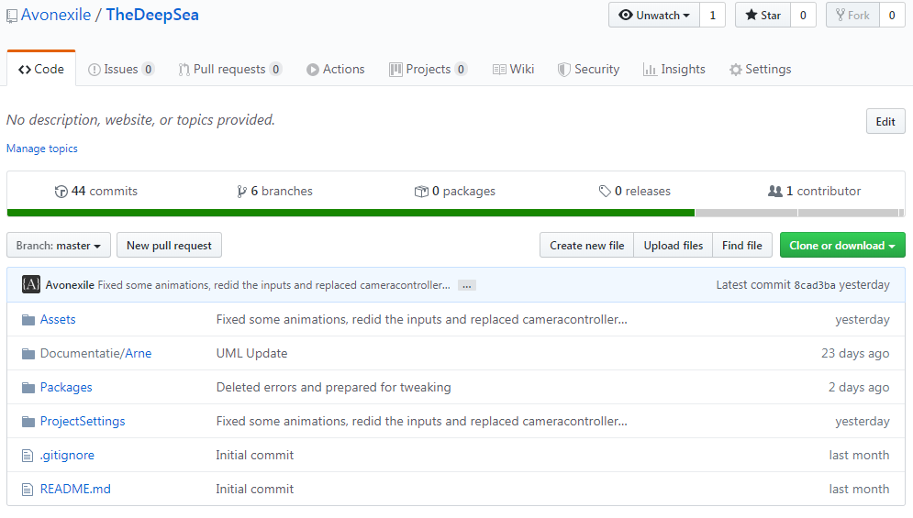
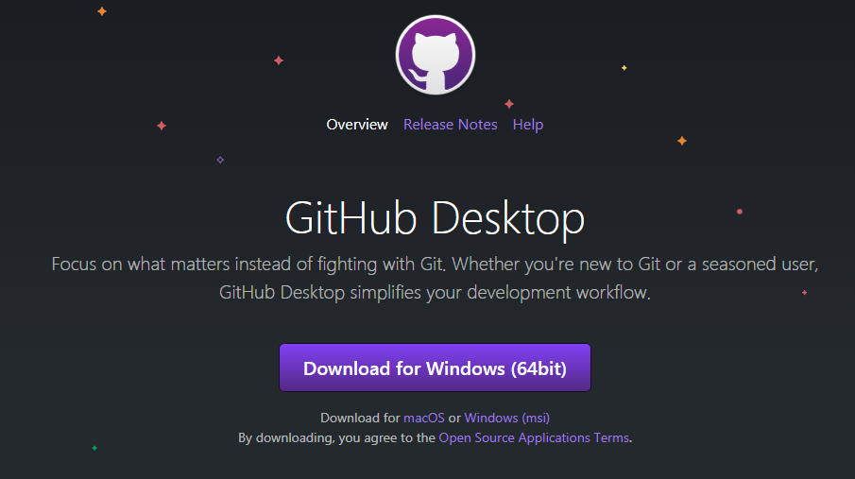
Software
Inrichting
Github repository (github site)
Maak repository
Github desktop
Nieuwste versie
Visual studio 2019
https://visualstudio.microsoft.com/vs/
Unity Hub
https://unity3d.com/get-unity/download
Unity
Via Unity Hub
Versie 2019.2.19f1

